Slide 1

Expand course7-Choose a song
Yahboom
Yahboom OMIBOX Tutorial

Slide 2
1
2
3
4
5
Learning
goals
Search for
blocks
Combine
blocks
Experimental
phenomena
Preparation
程序编程
Tencent
Yahboom OMIBOX Tutorial

Slide 3
1
Preparation-1
1. The position of the button, buzzer, RGB lights,LED matrix in the robot car
2. Learn how to control them by graphically programming
Yahboom OMIBOX Tutorial

Slide 4
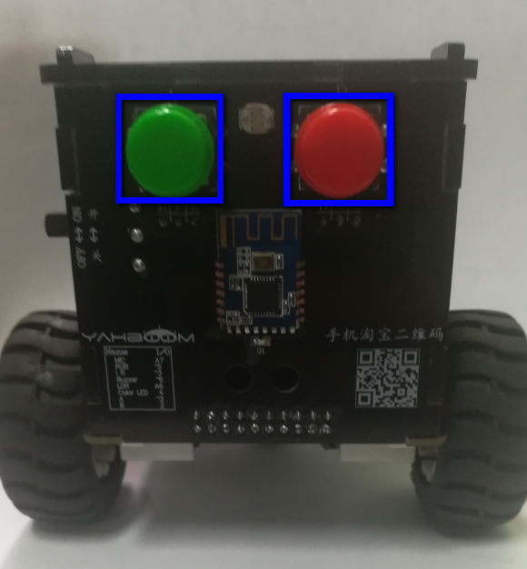
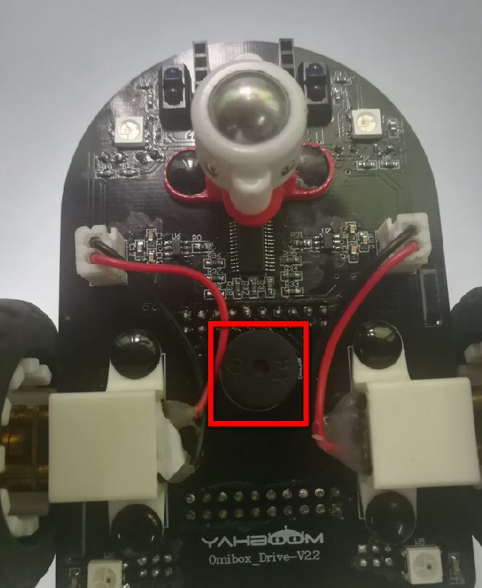
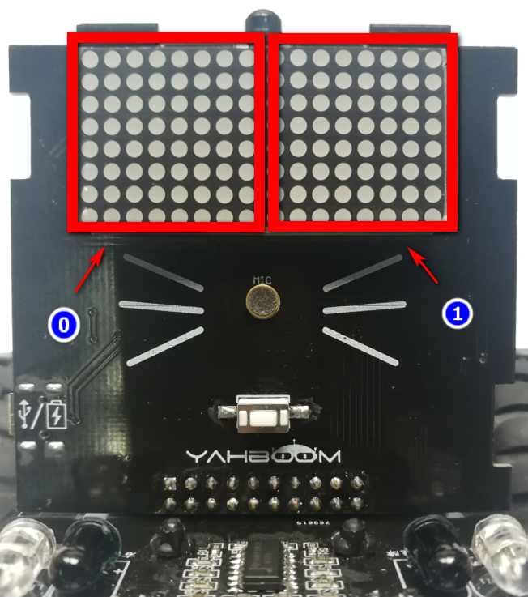
1
Preparation-2
As shown in the figure above,we circled the blue wire frame with two buttons, we circled the red wire frame with buzzer and two LED matrix . We can control them by programming.
Yahboom OMIBOX Tutorial

Slide 5
2
Learning goals
In this lesson, we will learn how to use buttons, dot matrix, magic lights, and buzzer.
When we press the red button, the LED matrix will scroll "RED" to the left, all RGB lights will become red, the buzzer plays the song "Ode".
When we press the green button, the LED matrix will scroll "GREEN" to the left, then all RGB lights will become green, the buzzer plays the song “Little star”.
Yahboom OMIBOX Tutorial

Slide 6
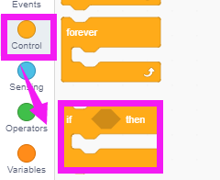
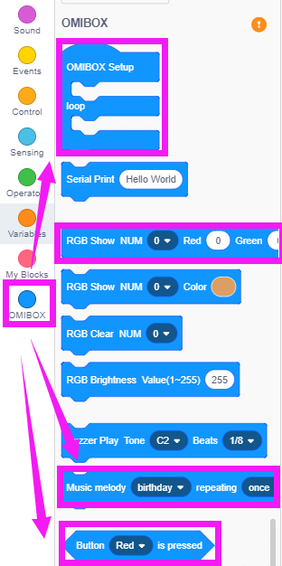
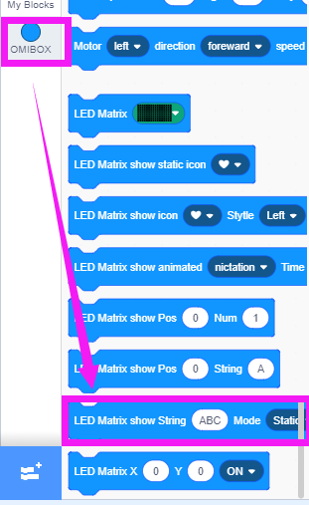
3
Search for blocks
The following is the location of the building blocks required for this programming.
Yahboom OMIBOX Tutorial

Slide 7
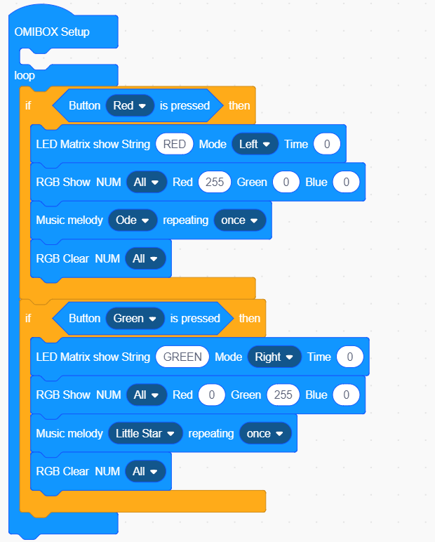
4
Combine blocks
The summary program is shown below:
Yahboom OMIBOX Tutorial

Slide 8
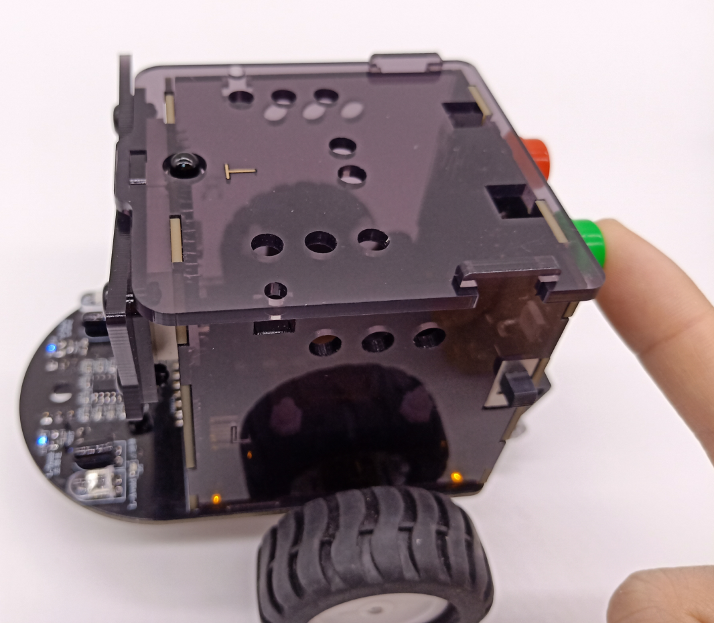
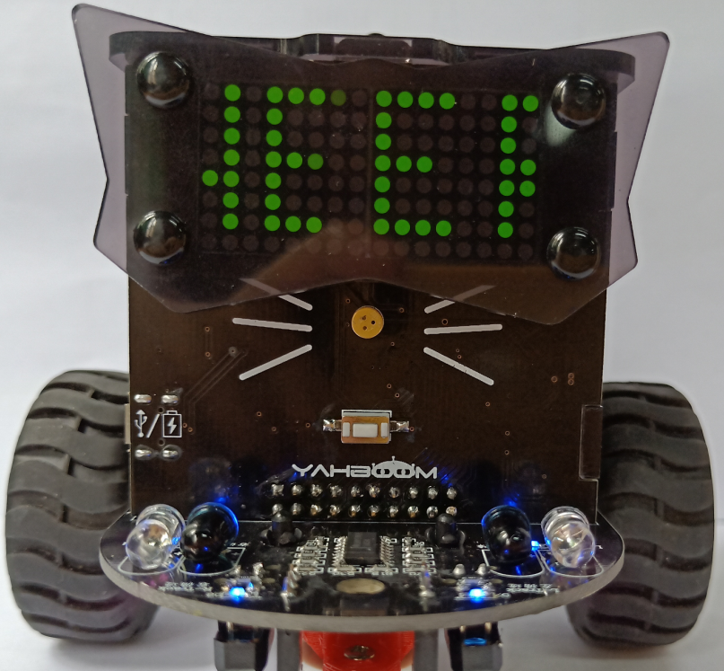
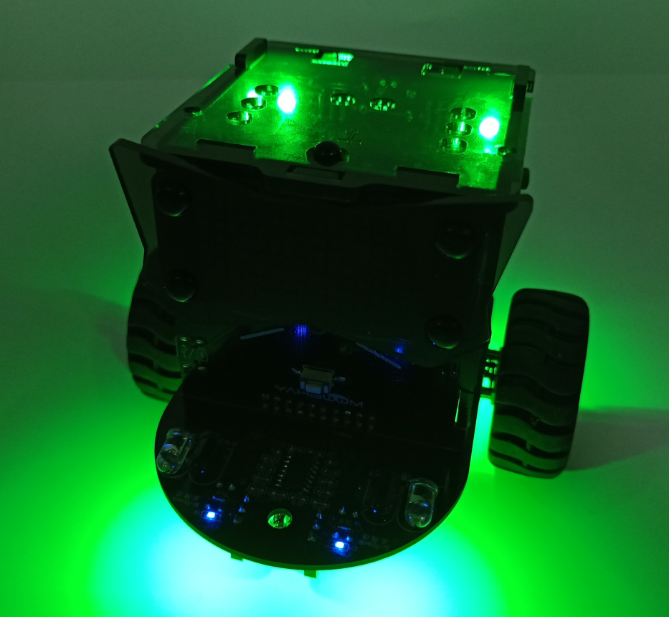
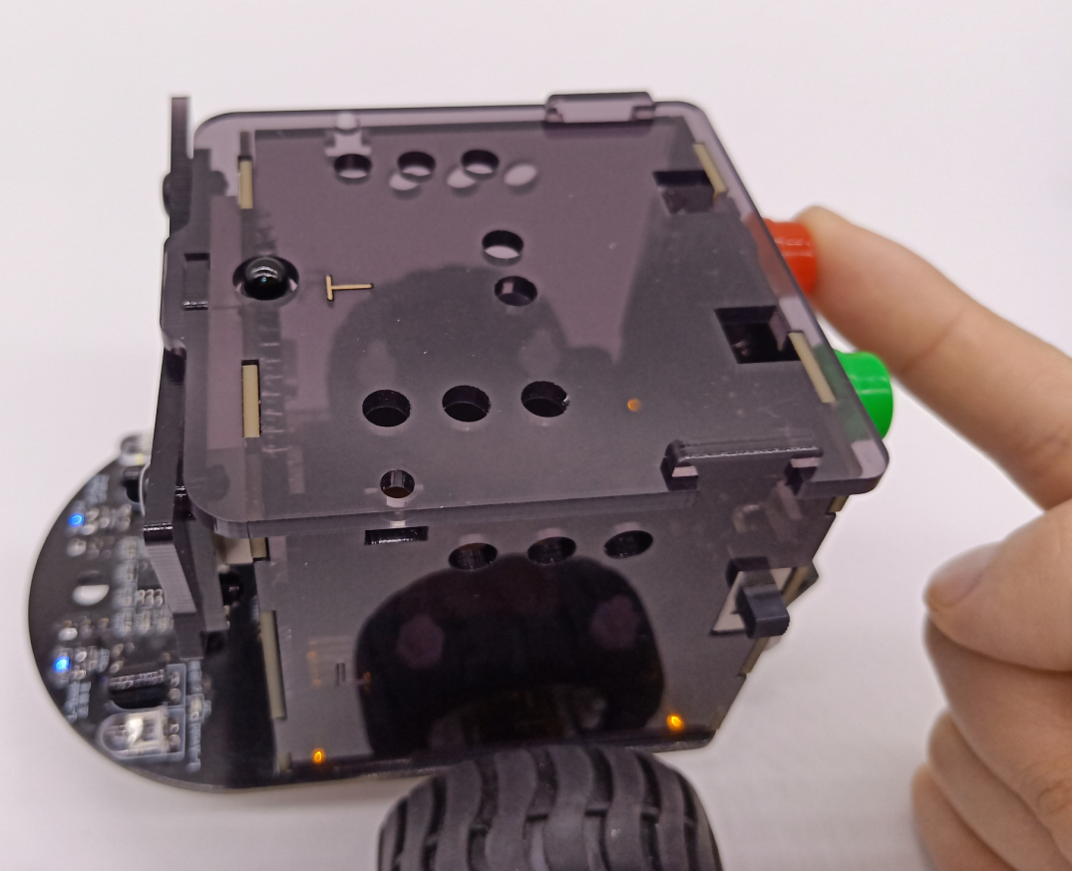
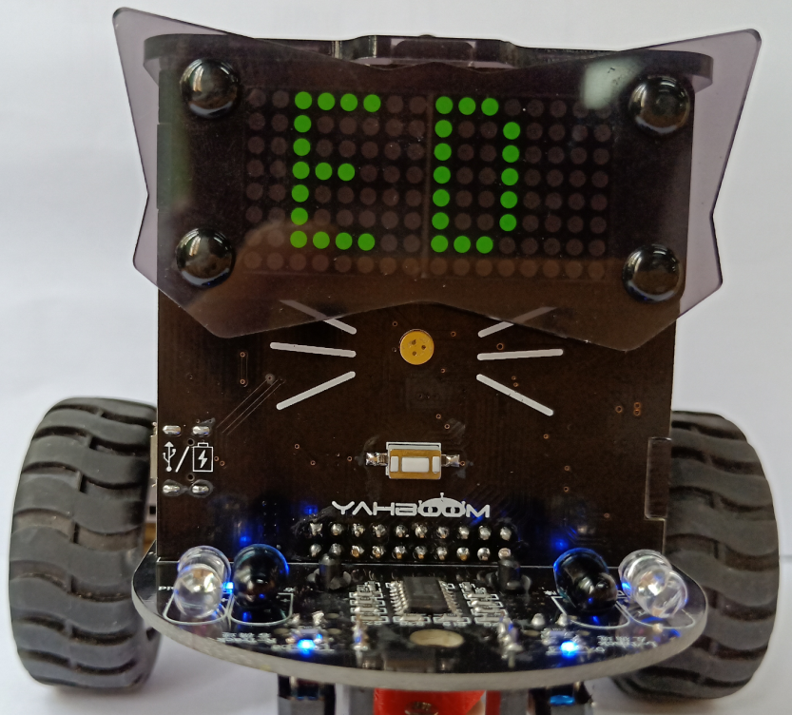
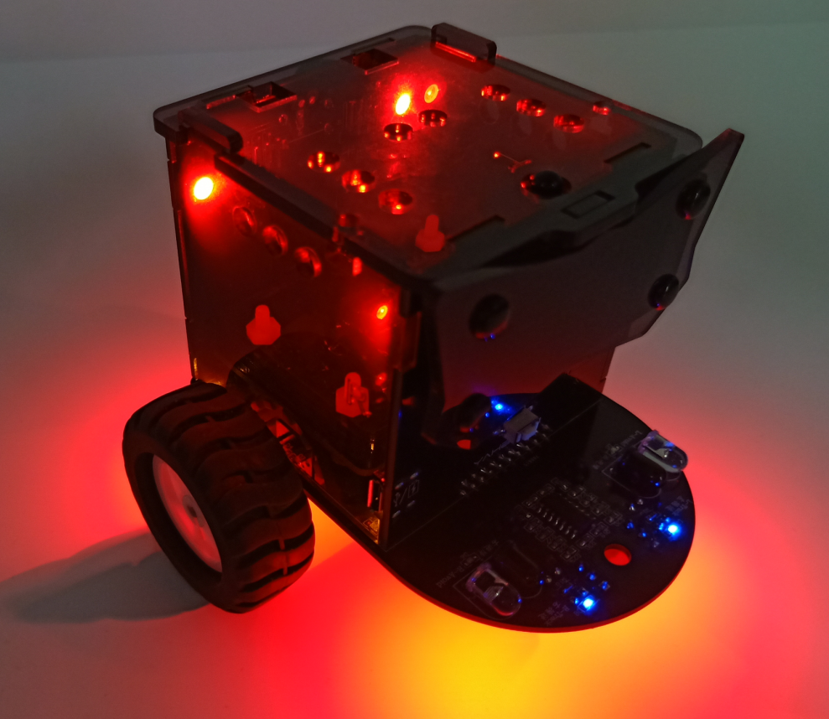
5
Experimental phenomena
After the program is uploaded, the car is powered on normally. When we press the red button, the LED matrix will scroll "RED" to the left, all RGB lights will become red, the buzzer plays the song "Ode".
When we press the green button, the LED matrix will scroll "GREEN" to the left, then all RGB lights will become green, the buzzer plays the song “Little star”.
Yahboom OMIBOX Tutorial

Slide 9
Inspire Creativity Embrace Innovation
Thank you!!!
Yahboom

